Slide 1
Dynamic Programming
Fang Xiaolin
School of Computer Science and Engineering
Southeast University

Slide 2
Outline
Dynamic Programming
Matrix Chain Multiplication
Steel Pipe Cut
Longest Common Subsequence
Optimal Binary Search Tree
Johnson‘s algorithm
0/1 Knapsack

Slide 3
Dynamic Programming
Divide and Conquer
Subproblems are independent
Dynamic Programming
Have many subproblems
Subproblems can be used many times
A subproblem can only be computed once

Slide 4
Dynamic Programming
Sufficient condition
Solution includes the optimal results of subproblems
Subproblems can be used many times

Slide 5
Matrix Chain Multiplication
Aatrix A and B Multiplication
A is p×q, B is q×r
A*B needs p×q×r multiplication operations

Slide 6
Matrix Chain Multiplication
3 matrix multiplication M₁M₂M₃ , they are 10×100, 100×5 and 5×50 respectively
M₁(M₂M₃)
M₂M₃: 100×5×50 = 25000
M₁(M₂M₃): 10×100×50 = 50000
Total operations: 25,000+50,000= 75,000
(M₁M₂)M₃
M₁M₂: 10×100×5 = 5000
(M₁M₂)M₃ : 10×5×50 = 2500
Total operations: 5,000+2,500=7,500
Different order different computing cost

Slide 7
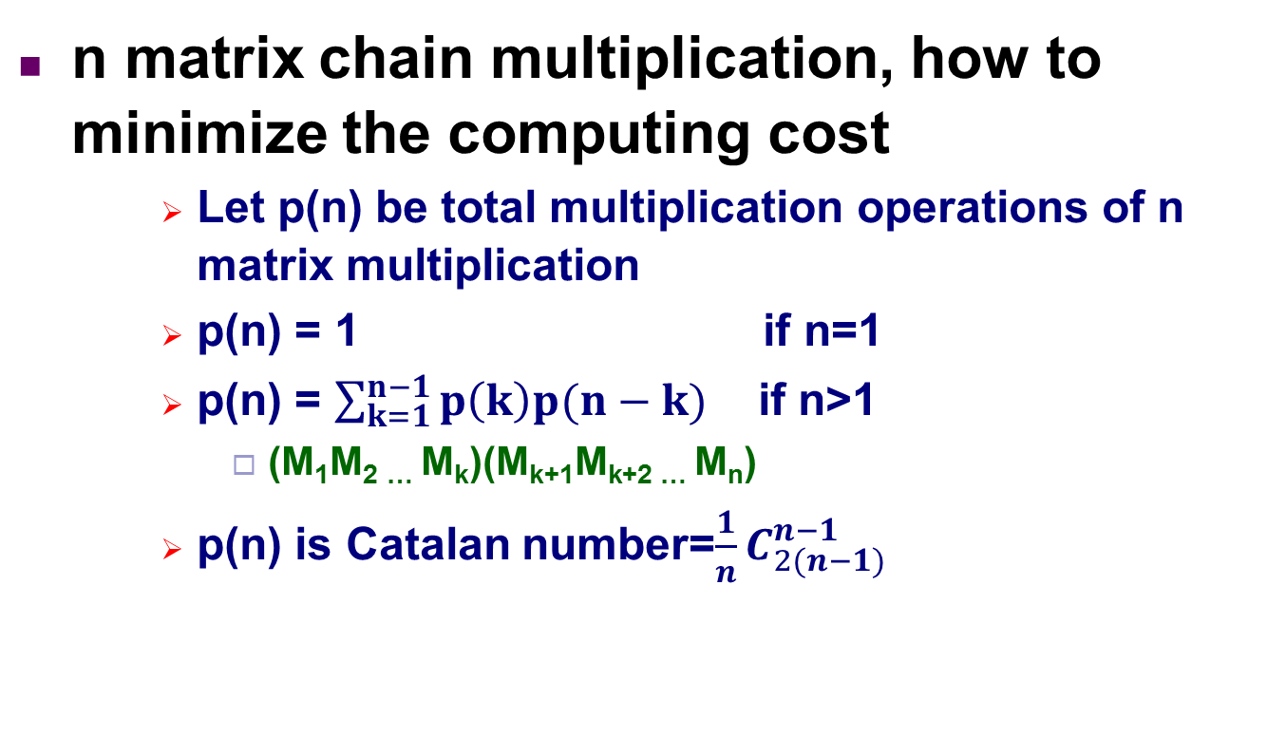
Matrix Chain Multiplication
n matrix chain multiplication, how to minimize the computing cost
Let p(n) be total multiplication operations of n matrix multiplication
p(n) = 1 if n=1
p(n) = $\sum_{k=1}^{n−1}{p\left(k\right)p(n−k)}$ if n>1
(M₁M₂ … M_{k})(M_{k+1}M_{k+2} … M_{n})
p(n) is Catalan number=$\frac{1}{n}C_{2(n−1)}^{n−1}$

Slide 8
Matrix Chain Multiplication
n matrix chain multiplication, how to minimize the computing cost
If we get the minimum cost of Subproblem M₁M₂ … M_{k} and M_{k+1}M_{k+2} … M_{n}
Then we get the minimum computing cost of (M₁M₂ … M_{k})(M_{k+1}M_{k+2} … M_{n})
Let min cost of M₁M₂ … M_{k} be m[1,k]
Let min cost of M_{k+1}M_{k+2} … M_{n} be m[k+1,n]
The min cost of (M₁M₂ … M_{k})(M_{k+1}M_{k+2} … M_{n})
m[1,k] + m[k+1,n] +r₁×r_{k}×r_{n}

Slide 9
Matrix Chain Multiplication
M₁M₂M₃M₄
M₁ (M₂M₃M₄)
(M₁M₂) (M₃M₄)
(M₁M₂M₃) M₄
M₂M₃
M₃M₄
M₁M₂
M₃M₄
M₁M₂
M₂M₃
Subproblems can be used many times

Slide 10
Matrix Chain Multiplication
Let m[i,j] be min cost of M_{i}M_{i+1} … M_{j}
Let m[1,n] be min cost of M₁M₂ … M_{n}
Then min cost (M_{i}M₂ … M_{k})(M_{k+1}M_{k+2} … M_{j})
m[i,j] = m[i,k] + m[k+1,j]+r_{i}×r_{k}×r_{j}
Enumerate every k
m[i,j] = min_{i≤k<j}{m[i,k] + m[k+1,j] +r_{i}×r_{k}×r_{j}}, if i<j
m[i,j] = 0, if i=j

Slide 11
Matrix Chain Multiplication
m[i,j] = min_{i≤k<j}{m[i,k] + m[k+1,j] +r_{i}×r_{k}×r_{j}}, if i<j
m[i,j] = 0, if i=j
m[1,1]
m[1,2]
m[1,3]
m[1,4]
m[1,5]
m[2,2]
m[2,3]
m[2,4]
m[2,5]
m[3,3]
m[3,4]
m[3,5]
m[4,4]
m[4,5]
m[5,5]

Slide 12
Matrix Chain Multiplication
Matrix-Chain-Order(r)
n=length(r)；
for i=1 to n do
m[i, i]=0;
for x=1 to n-1 do
for i=1 to n-x do
j = i+x;
m[i, j] = ∞;
for k=i to j-1 do
q = m[i, k]+m[k+1, j]+r_{i-1}r_{k}r_{j}
if q<m[i, j] then
m[i,j]=q;
s[i,j]=k;
return m and s
Bottom up

Slide 13
Matrix Chain Multiplication
m[N,N], s[N,N] = -1;
MatrixChain (i, j)
if i=j then
m[i, j]=0;
return;
m[i, j] = ∞;
for k=i to j-1 do
a = m[i, k]; b = m[k+1, j];
if a == -1 then a = MatrixChain(i, k);
if b == -1 then b = MatrixChain(k+1, j);
q = a + b + r_{i-1}r_{k}r_{j}
if q<m[i, j] then
m[i,j]=q;
s[i,j]=k;
Top down

Slide 14
Steel Pipe Cut
Given length n meters steel pipe
1 segment 4m
4 segments 1m
2 segments 2m
1 segment 3m and 1 segment 1m
Price table
Length i
1
2
3
4
Price pi
1
5
8
9
2 seg. 2m, benefit=10 is maximized

Slide 15
Steel Pipe Cut
Problem definition
Given a length n meters steel pipe, and the price table pi (i=1,2,…,n), find a cutting solution to maximize the benefit

Slide 16
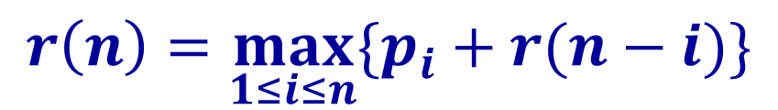
Steel Pipe Cut
Let r(n) be max benefit of n meter pipe
$$r\left(n\right)=\max_{1≤i≤n}{\{p_{i}+r(n−i)\}}$$

Slide 17
Steel Pipe Cut
Let r(n) be max benefit of n meter pipe
$$r\left(n\right)=\max_{1≤i≤n}{\{p_{i}+r(n−i)\}}$$
r(n)
r(n-1)
r(n-2)
r(n-3)
…
r(0)
Subproblems can be used many times
…
r(n-2)
r(n-3)
r(0)

Slide 18
Steel Pipe Cut
CUT(p, n, r)
r[0] = 0
for j=1 to n
temp = -∞
for i=1 to j
temp = max(temp, p[i]+r[j-i])
r[j] = temp
Bottom up
r[0]不用计算，依次计算r[1],r[2],r[3],r[4]

Slide 19
Steel Pipe Cut
Top down
define r[ ]，let r[i]=-∞
CUT(p, n, r)
if r[n]≥0 then return r[n]
if n == 0 then temp = 0
else
temp = -∞
for i=1 to n do
temp = max(temp , p[i]+CUT(p, n-i))
r[n] = temp
return temp
//r[n]不用重复计算了

Slide 20
Longest Common Subsequence
Subsequence
X=<x₁, x₂, … , x_{m}>, if 1≤i₁<i₂< ┅ <i_{k}≤m，and Z=< z₁, z₂,┅, z_{k}> = <x_{i1}, x_{i2},┅, x_{ik}>, then Z is a subsequence of X
X=(A, B, C, D, E, F, G)
Z=(B, C, E, F) is a subsequence of X
W=(B, D, A) is not a subsequence of X
Common Subsequence
Z is common subsequence of X and Y
Z is a subsequence of X
Z is a subsequence of Y

Slide 21
Longest Common Subsequence
LCS problem
input：X = (x₁,x₂,...,x_{n})，Y = (y₁,y₂,...y_{m})
output：Z is the longest common subsequence of X and Y

Slide 22
Longest Common Subsequence
i’th prefix
Let X=(x₁, x₂, ..., x_{n}) be a sequence
The i’th prefix X(i)=(x₁, ..., x_{i} )
E.g.：X=(A, B, D, C, A),
X(1)=(A), X(2)=(A, B), X(3)=(A, B, D)

Slide 23
Longest Common Subsequence
Analysis
Given X=(x₁, ..., x_{m}) and Y=(y₁, ..., y_{n}), assume Z=(z₁, ..., z_{k}) is LCS of X and Y
⑴ if x_{m}=y_{n},
Then z_{k}=x_{m}=y_{n}, Z(k-1) is LCS of X(m-1) and Y(n-1)
LCS(m,n) = LCS(m-1,n-1) + 1.
⑵ if x_{m}≠y_{n}
If z_{k}≠x_{m}，则 LCS(m,n)= LCS(m-1,n)
If z_{k}≠y_{n} ，则 LCS(m,n)= LCS(m,n-1)
LCS(m,n)=max{LCS(m-1,n), LCS(m,n-1)}
X=(x₁, x₂, ... , x_{m-1}, x_{m})
Y=(y₁, y₂, ... , y_{n-1}, y_{n})

Slide 24
Longest Common Subsequence
LCS(m,n)
LCS(m-1,n-1)
LCS(m-1,n)
LCS(m,n-1)
LCS(m-2,n-2)
LCS(m-2,n-1)
LCS(m-1,n-2)
……
Subproblems can be used many times

Slide 25
Longest Common Subsequence
LCS recurence
LCS[i,j]=0 if i=0 or j=0
LCS[i,j]=LCS[i-1, j-1] + 1 if i, j>0,x_{i}=y_{j}
LCS[i,j]=Max(LCS[i,j-1],LCS[i-1,j]) if i,j>0,x_{i}≠y_{j}

Slide 26
Longest Common Subsequence
Main idea
LCS[i-1, j-1]
LCS[i-1,j]
LCS[i, j-1]
LCS[i, j]

Slide 27
Longest Common Subsequence
Bottom up
LCS[0,0]
LCS[0,1]
LCS[0,2]
LCS[0,3]
LCS[0,4]
LCS[1,0]
LCS[1,1]
LCS[1,2]
LCS[1,3]
LCS[1,4]
LCS[2,0]
LCS[2,1]
LCS[2,2]
LCS[2,3]
LCS[2,4]
LCS[3,0]
LCS[3,1]
LCS[3,2]
LCS[3,3]
LCS[3,4]

Slide 28
Longest Common Subsequence
Top down
LCS[0,0]
LCS[0,1]
LCS[0,2]
LCS[0,3]
LCS[0,4]
LCS[1,0]
LCS[1,1]
LCS[1,2]
LCS[1,3]
LCS[1,4]
LCS[2,0]
LCS[2,1]
LCS[2,2]
LCS[2,3]
LCS[2,4]
LCS[3,0]
LCS[3,1]
LCS[3,2]
LCS[3,3]
LCS[3,4]

Slide 29
Longest Common Subsequence
for i=0 to m do LCS[i,0]←0
for j=1 to n do LCS[0,j]←0
for i=1 to m do
for j=1 to n do
if X[i]=Y[j] then
LCS[i,j] = LCS[i-1,j-1]+1;
b[i,j] = “↖” ;
else if LCS[i-1,j]≥C[i,j-1] then
LCS[i,j] = LCS[i-1,j]；
b[i,j] = “↑” ;
else
LCS[i,j] = LCS[i,j-1]；
b[i,j] = “←” ;
Time cost O(mn)
Memory cost O(mn)

Slide 30
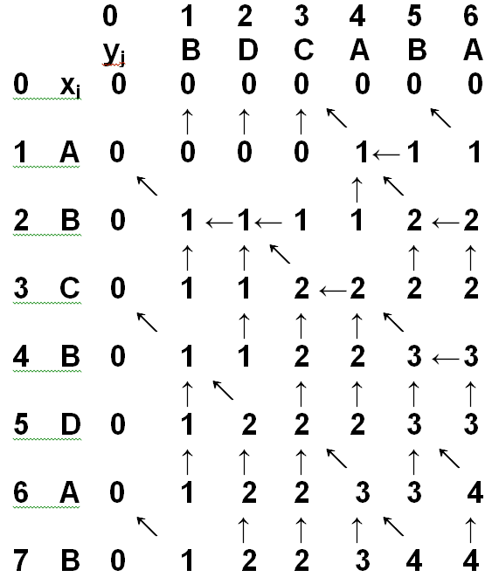
Longest Common Subsequence

Slide 31
Optimal Binary Search Tree
Problem
Given n keys，each has a search probability，search fails also have probabilities, construct a binary search tree to minimize average search length
E.g.，3 key ={10，20，30}，search success probs. P={0.5, 0.1, 0.05}，search fail probs. Q={0.15, 0.1, 0.05, 0.05}
0.5
0.1
0.05
10
20
30
0.15
0.1
0.05
0.05

Slide 32
Optimal Binary Search Tree
P₁P₂P₃P₄
P₁ (P₂P₃P₄)
(P₁)P₂(P₃P₄)
(P₁P₂)P₃(P₄)
(P₁P₂P₃)P₄
P₂P₃
P₃P₄
P₃P₄
P₁P₂
P₁P₂
P₂P₃
Subproblems can be used many times

Slide 33
Optimal Binary Search Tree
Solution
c(i,j) be optimal cost from key i+1 to j ，
c(0,n) is the final result
w(i,j) be total probs. of key i+1 to j , and space i to j
w(i,j) = (q_{i}+…+q_{j}) + (p_{i+1}+…+ p_{j})
w(i, j)=w(i, j-1)+p_{j}+q_{j}
p₁
p₂
p₃
p₄
p₅
p₆
10
20
30
40
50
60
q₀
q₁
q₂
q₃
q₄
q₅
q₆
W(2,5)=(q₂+q₃+q₄+q₅) + (p₃+p₄+p₅)

Slide 34
Optimal Binary Search Tree
Solution
c(i,j) be optimal cost from key i+1 to j ，
c(0,n) is the final result
w(i,j) be total probs. of key i+1 to j , and space i to j
w(i,j) = (q_{i}+…+q_{j}) + (p_{i+1}+…+ p_{j})
Key i+1, … , j, search cost root at key k：
= p_{k} + c(i,k-1)+w(i,k-1) + c(k,j)+w(k,j)
Left subtree cost
Right subtree cost
Root prob
Total prob of left subtree
Total prob of right subtree

Slide 35
Optimal Binary Search Tree
Solution
c(i,j) be optimal cost from key i+1 to j ，
c(0,n) is the final result
w(i,j) be total probs. of key i+1 to j , and space i to j
w(i,j) = (q_{i}+…+q_{j}) + (p_{i+1}+…+ p_{j})
Key i+1, … , j, search cost root at key k：
= p_{k} + c(i,k-1)+w(i,k-1) + c(k,j)+w(k,j)
= w(i,j) + c(i,k-1) + c(k,j)
Left subtree cost
Total prob
Right subtree cost

Slide 36
Optimal Binary Search Tree
Solution
c(i,j) be optimal cost from key i+1 to j ，
c(0,n) is the final result
w(i,j) be total probs. of key i+1 to j , and space i to j
w(i,j) = (q_{i}+…+q_{j}) + (p_{i+1}+…+ p_{j})
Key i+1, … , j, search cost root at key k：
= p_{k} + c(i,k-1)+w(i,k-1) + c(k,j)+w(k,j)
= w(i,j) + c(i,k-1) + c(k,j)
Key i+1, … , j, final optimal search cost：
c(i,j) = w(i,j) + min{ c(i,k-1) + c(k,j) }, 其中i < k ≤ j
树上权值和
左右子树代价和最小值

Slide 37
Optimal Binary Search Tree
Solution
c(i,j) be optimal cost from key i+1 to j ，
c(0,n) is the final result
c(i,j) = w(i,j) + min{ c(i,k-1) + c(k,j) }, i < k ≤ j
p₁
p₂
p₃
p₄
p₅
p₆
10
20
30
40
50
60
q₀
q₁
q₂
q₃
q₄
q₅
q₆
c(0,6)=w(0,6)+min{c(0,k)+c(k,6)}, 0 < k ≤ 6

Slide 38
Optimal Binary Search Tree
Solution
c(i,j) be optimal cost from key i+1 to j ，
c(0,n) is the final result
c(i,j) = w(i,j) + min{ c(i,k-1) + c(k,j) }, i < k ≤ j
p₁
10
p₂
p₃
p₄
p₅
p₆
q₀
20
30
40
50
60
q₁
q₂
q₃
q₄
q₅
q₆
c(0,6)=w(0,6)+min{c(0,k)+c(k,6)}, 0 < k ≤ 6

Slide 39
Optimal Binary Search Tree
Solution
c(i,j) be optimal cost from key i+1 to j ，
c(0,n) is the final result
c(i,j) = w(i,j) + min{ c(i,k-1) + c(k,j) }, i < k ≤ j
p₂
20
p₁
p₃
p₄
p₅
p₆
10
30
40
50
60
q₀
q₁
q₂
q₃
q₄
q₅
q₆
c(0,6)=w(0,6)+min{c(0,k)+c(k,6)}, 0 < k ≤ 6

Slide 40
Optimal Binary Search Tree
Solution
c(i,j) be optimal cost from key i+1 to j ，
c(0,n) is the final result
c(i,j) = w(i,j) + min{ c(i,k-1) + c(k,j) }, i < k ≤ j
p₃
30
p₁
p₂
p₄
p₅
p₆
10
20
40
50
60
q₀
q₁
q₂
q₃
q₄
q₅
q₆
c(0,6)=w(0,6)+min{c(0,k)+c(k,6)}, 0 < k ≤ 6

Slide 41
Optimal Binary Search Tree
Solution
c(i,j) be optimal cost from key i+1 to j ，
c(0,n) is the final result
c(i,j) = w(i,j) + min{ c(i,k-1) + c(k,j) }, i < k ≤ j
p₄
40
p₁
p₂
p₃
p₅
p₆
10
20
30
50
60
q₀
q₁
q₂
q₃
q₄
q₅
q₆
c(0,6)=w(0,6)+min{c(0,k)+c(k,6)}, 0 < k ≤ 6

Slide 42
Optimal Binary Search Tree
Solution
c(i,j) be optimal cost from key i+1 to j ，
c(0,n) is the final result
c(i,j) = w(i,j) + min{ c(i,k-1) + c(k,j) }, i < k ≤ j
p₅
50
p₁
p₂
p₃
p₄
p₆
10
20
30
40
60
q₀
q₁
q₂
q₃
q₄
q₅
q₆
c(0,6)=w(0,6)+min{c(0,k)+c(k,6)}, 0 < k ≤ 6

Slide 43
Optimal Binary Search Tree
Solution
c(i,j) be optimal cost from key i+1 to j ，
c(0,n) is the final result
c(i,j) = w(i,j) + min{ c(i,k-1) + c(k,j) }, i < k ≤ j
p₆
60
p₁
p₂
p₃
p₄
p₅
10
20
30
40
50
q₆
q₀
q₁
q₂
q₃
q₄
q₅
c(0,6)=w(0,6)+min{c(0,k)+c(k,6)}, 0 < k ≤ 6

Slide 44
Optimal Binary Sear
0.5
0.1
0.05
10
20
30
0.15
0.1
0.05
0.05
Step 1：each key constructs a tree
0.5
10
0.1
20
0.05
30
0.15
0.1
0.1
0.05
0.05
0.05
w=0.75
w=0.25
w=0.15
c(0,1)=0.75
c(1,2)=0.25
c(2,3)=0.15
c(0,1)=0.75
w is total probs of all nodes
c is total probs of all nodes
c(1,2)=0.25
c(2,3)=0.15

Slide 45
Optimal Binary Sear
0.5
0.1
0.05
10
20
30
0.15
0.1
0.05
0.05
Step 2：adjacent 2 keys construct a tree
0.5
10
0.1
20
0.1
20
0.05
30
20
0.1
0.5
10
30
0.05
0.1
20
0.15
0.05
0.1
0.05
0.1
0.05
0.15
0.1
0.05
0.05
0.1
0.05
c(1,2)
c(0,1)
c(2,3)
c(1,2)
c(0,2)=w+c(1,2)
=1.15
c(0,2)=w+c(0,1)
=1.65
c(1,3)=w+c(2,3)
=0.5
c(1,3)=w+c(0,1)
=0.6
c(0,1)=0.75
c(0,2)=1.15
w is total probs of all nodes
c=w+c_left+c_right
c(1,2)=0.25
c(1,3)=0.5
c(2,3)=0.15

Slide 46
Optimal Binary Sear
0.5
0.1
0.05
10
20
30
0.15
0.1
0.05
0.05
Step 3：adjacent 3 keys construct a tree
0.5
10
0.05
30
0.1
20
20
0.1
0.5
10
0.15
0.05
0.5
10
30
0.05
30
0.05
20
0.1
0.1
0.15
0.15
0.1
0.05
0.05
0.05
0.05
0.1
0.05
c(0,3)=w+c(1,3)
=1.5
c(0,3)=w+c(0,1)+c(2,3)
=1.9
c(0,3)=w+c(0,2)
=2.15
c(0,1)=0.75
c(0,2)=1.15
c(0,3)=1.5
w is total probs of all nodes
c=w+c_left+c_right
c(1,2)=0.25
c(1,3)=0.5
c(2,3)=0.15

Slide 47
Optimal Binary Search Tree
Optimal-BST(p, q, n)
for i=0 to n do
C(i, i) = 0;
W(i, i) = q_{i};
for x=1 to n do
for i=0 to n-x do
j=i+x;
C(i, j)=∞;
W(i, j)=W(i, j-1)+p_{j}+q_{j};
for k=i to j do
t = W(i,j);
if k-1≥i then t += C(i, k-1);
if k+1≤j then t += C(k+1, j);
if t < C(i, j) then C(i, j)=t; Root(i, j)=r;
Time cost O(n³)
Memory costO(n²)

Slide 48
Johnson‘s algorithm
Problem definition
n jobs N={1，2，…，n},each must be run on 2 machines M1 and M2 one by one, each job must be run on M1 and then M2, the processing time on M1 and M2 for job i is ai and bi respectively
One machine run at most one job at one time
How to schedule the jobs to minimize the makespan

Slide 49
Johnson‘s algorithm
Exist a schedule where jobs on M1 are continuous
makespan on M1 is ∑ai
It’s not true for M2
Exist a schedule where the job orders on M1 and M2 are the same
M1
…
ai
…
aj
…
M2
…
bi
…
bj
…
M2
…
bj
…
bi
…
Only need to consider such schedule
Notes:
若是bi和bj交换，则bj需要aj结束，等待时间更长

Slide 50
Johnson‘s algorithm
Job set N={1,2,…,n}，subset S ⊆ N
Assume M1 is free to process job in S, M2 is busy and it needs to wait time t.
Let T(S,t) be makespan for processing jobs in S
Then T(N,0) is the final result
T(N,0)=min{ai + T(N-{i}, bi)}, i∈N
ai：choose job i to be processed on M1
T(N-{i},bi}：process the left jobs N-{i}, but M2 is busy and it needs to wait time bi

Slide 51
Johnson‘s algorithm
Job set N={1,2,…,n}，subset S ⊆ N
Assume M1 is free to process job in S, M2 is busy and it needs to wait time t.
Let T(S,t) be makespan for processing jobs in S
Then T(N,0) is the final result
T(S,t)={ai + T(S-{i}, bi+max{t-ai,0})}, i∈S
ai： choose job i to be processed on M1
T(S-{i}, bi+max{t-ai,0})：process the left jobs S-{i}, but M2 is busy and it needs to wait time bi+max{t-ai,0}

Slide 52
Johnson‘s algorithm
T(S,t)={ai + T(S-{i}, bi+max{t-ai,0})}, i∈S
M1
M1
ai
M1
ai
M2
M2
M2
t
t
t
T(S,t)
ai + T(S-{i}, bi)
ai + T(S-{i}, bi+t-ai)
Job i can only be processed after max{t,ai}, therefore, remove job i, the remaining jobs can be processed on M2 after time bi+max{t,ai}, -ai=bi+max{t-ai,0}

Slide 53
Johnson‘s algorithm
Subproblems can be used many times?
T(N,0)
T(N-{1},b1)
T(N-{2},b2)
……
T(N-{n},bn)
?
T(N-{1,4},b4+max{b1-a4,0})
……
T(N-{1,3},b3+max{b1-a3,0})
T(N-{1,2},b2+max{b1-a2,0})
The number of subproblems is 2^{n}-1

Slide 54
Johnson‘s algorithm
Johnson’s rule
Let first two jobs in OPT schedule be i and j
T(S,t) = ai + T(S-{i}, bi+max{t-ai,0})
= ai + aj + T(S-{i,j}, tij)
tij = bj + max{bi+max{t-ai,0}-aj,0}
= bj+bi-aj + max{max{t-ai,0}, aj-bi}
= bj+bi-aj + max{t-ai,aj-bi,0}
= bj+bi-aj-ai + max{t,ai+aj-bi, ai}
if job i and j satisfy min{bi,aj} ≥ min{bj,ai}, then job i and j satisfy Johnson’s rule

Slide 55
Johnson‘s algorithm
tij ≤ tji, optimal solution satisfies Johnson’s rule
Johnson不等式
Let first two jobs in OPT schedule be i and j
T(S,t) = ai + T(S-{i}, bi+max{t-ai,0})
= ai + aj + T(S-{i,j}, tij)
tij = bj+bi-aj-ai + max{t,ai+aj-bi, ai}，swap(i,j)
tji = bj+bi-aj-ai + max{t,ai+aj-bj, aj}
Johnson’s rule：min{bi,aj} ≥ min{bj,ai},
max{-bi,-aj} ≤ max{-bj,-aj}
ai+aj+max{-bi,-aj} ≤ ai+aj+max{-bj,-ai}
max{ai+aj-bi,ai} ≤ max{ai+aj-bj,aj}
max{t,ai+aj-bi,ai} ≤ max{t,ai+aj-bj,aj}

Slide 56
Johnson‘s algorithm
Johnson’s algorithm
Johnson’s rule：if min{bi,aj} ≥ min{bj,ai}, then job i should be processed before job j.
In general case：
If min{a₁, a₂, … , a_{n} , b₁, b₂,…, b_{n} }=ai, then any k≠i, it has min{b_{i}, a_{k}} ≥ min{b_{k}, a_{i}}, then i shedule first
If min{a₁, a₂,… , a_{n} , b₁, b₂,… , b_{n} }=bj, then any k≠j, it has min{b_{k}, a_{j}} ≥ min{b_{j}, a_{k}}then j shedule last

Slide 57
Johnson‘s algorithm
Johnson’s algorithm
(a1, a2, a3, a4) = (5, 12, 4, 8)
(b1, b2, b3, b4) = (6, 2, 14, 7)
job
1
2
3
4
a
5
12
4
8
b
6
2
14
7
schedule
3
1
4
2

Slide 58
0/1 knapsack
Problem definition
given n object and one container, object i has size w_{i}，value v_{i} , container has capacity C, select a subset of objects to maximize the total value while meet the capacity constraint
Objects can not be cut, each object can only be put into the container or not, that is 1 or 0

Slide 59
0/1 knapsack
形式描述
input：C > 0, w_{i} > 0, v_{i} >0, 1≤ i ≤ n
output：(x₁, x₂, …, x_{n}), x_{i}∈{0, 1}, satisfying Σ_{1≤ i ≤ n}w_{i} x_{i} ≤ C, and maximize Σ_{1 ≤ i ≤ n}v_{i} x_{i}
This is an integer programming problem
max{Σ_{1 ≤ i ≤ n}v_{i} x_{i}}
Σ_{1≤ i ≤ n}w_{i} x_{i} ≤ C
x_{i}∈{0, 1}, 1 ≤ i ≤ n

Slide 60
0/1 knapsack
The subproblem
Let the maximum value be m(i, j)
max{Σ_{i ≤ k ≤ n}v_{k} x_{k}}
Σ_{i ≤ k ≤ n}w_{k} x_{k} ≤ j
x_{k}∈{0, 1}, i ≤ k ≤ n
m(i, j) represents the optimal solution where the capacity is j, and the objects set is {i, i+1, …, n}

Slide 61
0/1 knapsack
Recurrence
m(i, j) = m(i+1, j) 0≤ j < w_{i}
m(i, j) = max{m(i+1, j), m(i+1, j-w_{i})+v_{i}} j ≥ w_{i}
m(n, j) = 0 0 ≤ j < w_{n}
m(n, j) = v_{n} j ≥ w_{n}
m(1,C)
m(2,C-w₁)
m(2,C)
m(3, C-w₁-w₂)
m(3,C-w₂)
m(3,C-w₁)
m(3,C)
Notes:
若w1==w2，则m(3,c-w1)和m(3,c-w2)重叠

Slide 62
0/1 knapsack
for j = 0 to min(w_{n}-1, C) do
m[n, j] = 0;
for j = w_{n} to C do
m[n, j] = v_{n};
for i = n-1 to 2 do
for j=0 to min(w_{i} -1, C) do
m[i, j] = m[i+1, j];
for j=w_{i} to C do
m[i, j]=max{m[i+1, j], m[i+1, j-w_{i}]+v_{i}};
if C < w₁ then m[1, C]=m[2, C];
else m[1, C]=max{m[2, C], m[2, C-w₁]+v₁};
Notes:
若w1==w2，则m(3,c-w1)和m(3,c-w2)重叠

Slide 63
0/1 knapsack
构造最优解
m(1, C)是最优解代价值，相应解计算如下：
if m(1, C)=m(2, C) then
x₁=0
由m(2, C)继续构造最优解
Else
x₁=1;
由m(2, C-w₁)继续构造最优解
Notes:
若w1==w2，则m(3,c-w1)和m(3,c-w2)重叠

Slide 64
小结
问题一般采用动态规划法，当具有：
1）最优子结构性质时
2）高度重复性
若问题不是NP-hard问题
进一步分析后就有可能获得效率较高的算法。
若问题本身就是NP-hard问题
那么与其它的精确算法相比，动态规划法性能一般不算太坏

